Slide 1
Tactical & Strategic AI Session 15
Course : COMP6228 – Artificial Intelligence
Effective Period : February 2018

Slide 2
Learning Objective
After completing this session, students are expected to be able to:
LO 2 : Explain concepts of AI Techniques in Games

Slide 3
Content
Waypoint Tactics
Tactical Analyses

Slide 4
Waypoint Tactics
A waypoint is a single position in the game level. Pathfinding uses nodes as intermediate points along a route through the level. This was the original use of waypoints, and the techniques in this section grew naturally from extending the data needed for pathfinding to allow other kinds of decision making.
More common in games is the use of tactical locations to represent defensive locations, or cover points.
In a static area of the game, the designer will typically mark locations behind barrels or protruding walls as being good cover points. When a character engages the enemy, it will move to the nearest cover point in order to provide itself with some shelter

Slide 5
Tactical Analyses
There are unlimited different ways to use waypoints to represent tactical information, such as:
Mark fire points where a large arc of fire can be achieved
Power-up points where power-ups are likely to respawn
Reconnaissance points where a large area can be viewed easily
Quick exit points where characters can hide with many escape options if they are found
Etc.
Tactical points can even be locations to avoid, such as ambush hotspots, exposed areas, or sinking sand.

Slide 6
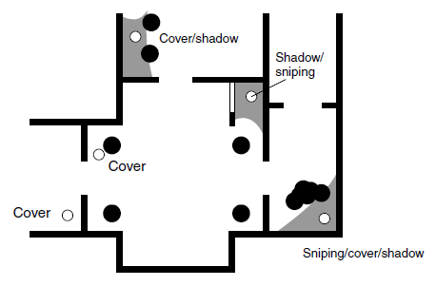
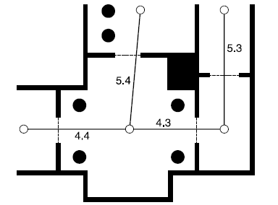
Tactical Analyses
A Set of Locations
Locations for cover and sniper fire are not very useful as part of a pathfinding graph. Although it is most common to combine the two sets of waypoints, it may provide more efficient pathfinding to have a separate pathfinding graph and tactical location set

Slide 7
Tactical Analyses
Using Tactical Information Like Any Other Data
The simplest way to bring tactical information into the decision making process is to give the decision maker access to it in the same way as it has access to other information about the game world
If we want to use a decision tree, for example, we could allow decisions to be made based on the tactical context of the character. We might make a decision based on the nearest cover point
if we are using a state machine we might only trigger certain transitions based on the availability of waypoints

Slide 8
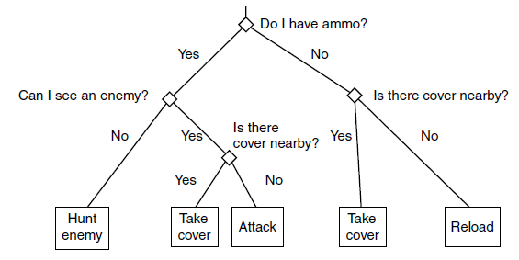
Tactical Analyses
Example Tactical information in Decision Tree

Slide 9
References
Ian Millington. 2009. Artificial intelligence for games. Morgan Kaufmann Publishers. Burlington. ISBN:9780123747310
Hierarchical Plan Representations for Encoding Strategic Game AI, http://www.aaai.org/Papers/AIIDE/2005/AIIDE05-011.pdf

